Slide 1
Sources of International: What are its sources?
Shamshad Ahmad Khan, PhD
Department of HSS
BPDC

Slide 2

Sources of International Law
In domestic law, the identification of relevant legal sources is rarely a problem and there is traditionally a very definite method of ascertaining the law in any given subject matter.
In international law, the lack of a universal legislature and a system of courts with compulsory jurisdiction often make the task of uncovering the law more difficult.
Furthermore, since international law is a decentralized legal system, legal obligations may derive from more than one particular source.

Slide 3
International Customs (Customary laws), International Treaties, and conventions are sources of international law.
Article 38 of ICJ defines what could be considered IL and adjudicated by it.

Slide 4
Article 38
(1) The Court, whose function is to decide in accordance with international law such disputes as are submitted to it, shall apply:
(a) international conventions, whether general or particular, establishing rules expressly recognized by the contesting states;
(b) international custom, as evidence of a general practice accepted as law;
(c) the general principles of law recognized by civilized nations;
(d) subject to the provisions of Article 59, judicial decisions and the teachings of the most highly qualified publicists of the various nations, as subsidiary means for the determination of rules of law,
Article 59. The decision of the Court has no binding force except between the parties and in respect of that particular case.

Slide 5
Conventions (treaties) as a legal source
Sub-clause: 1(a) international conventions, whether general or particular, establishing rules expressly recognized by the consenting states
Two states or more can sign a Convention or Treaty.
Consent of the state is important for the Treaty to come into effect. (Treaty cannot be imposed on a State.
The State can Withdraw/Terminate etc the Treaty at any stage.
Example: India Japan nuclear deal
https://www.mofa.go.jp/files/000202920.pdf

Slide 6

Int Treaties and Conventions
Also based on State Consent
Convention on Biological and weapons
https://www.un.org/disarmament/biological-weapons/about/history/

Slide 7
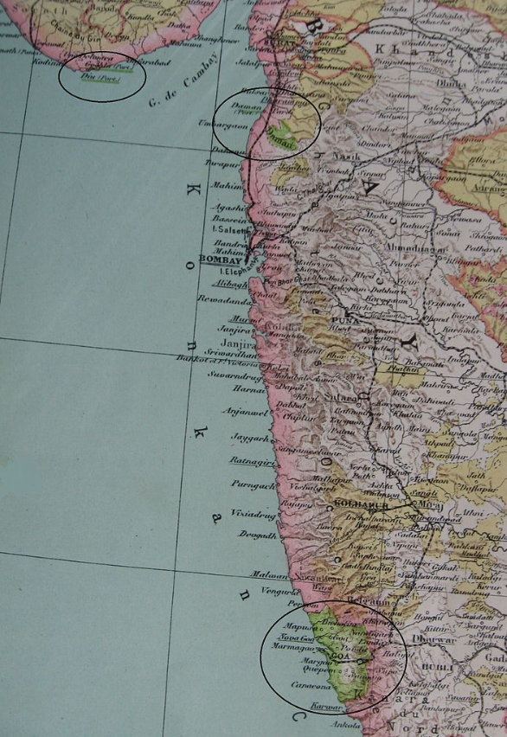
b) international custom, as evidence of a general practice accepted as law;
Customary rule binds all states (unless a state persistently objects*)
Customary legal norms need not be universal in scope, though
In Right of Passage over Indian Territory [1960], the ICJ stated that ‘long continued practice between two States accepted by them as regulating their relations’ can form the basis of mutual rights and obligations between those states’.
*Objects: S. Arabia objects to certain laws being formed citing local norms/customs

Slide 8
Note: Customary Law is conditioned with Jus Cogen (Compelling Law).
Jus cogens is the fundamental principle of IL which cannot be changed by Treaties and Customary IL
include universal provisions on ban on slavery, genocide, torture, slave trade.
(No two countries can make an agreement on slave trade etc)

Slide 9
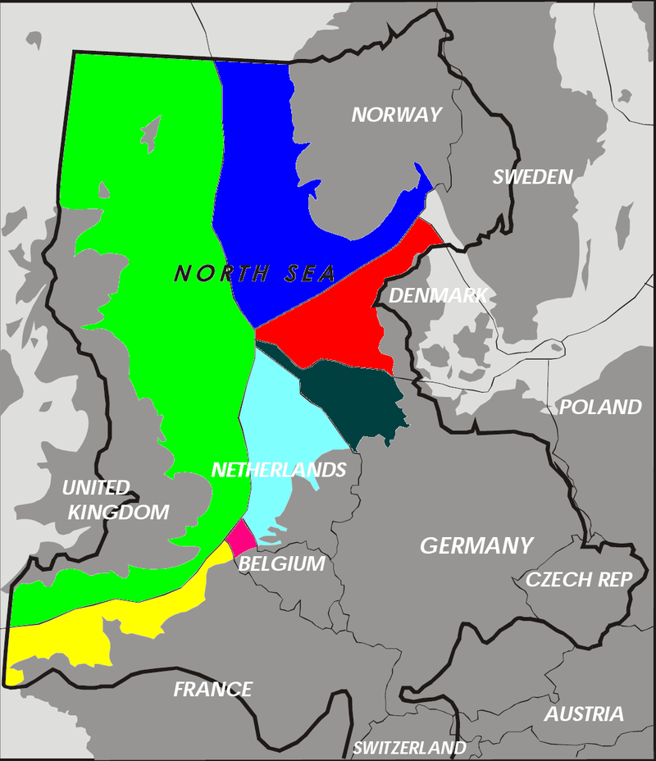
(c) the general principles of law recognized by civilized nations;
In the absence of a treaty/ convention Customs, General principles of international law would apply the logic of “principles of law recognized by civilized nations”
The most relevant general principle of international law is equity.
In the North Sea Continental Shelf Cases, for example, the Court relied on equitable principles when it delimited the continental shelf between West Germany, the Netherlands and Denmark.
International law also contains a general principle of good faith that stipulates that states must act honestly in the fulfilment of their international obligations.

Slide 10
https://www.reuters.com/article/us-health-tobacco-pmi-idUSKBN1FL3IB
With Roman Law Doctrine, India Moves to Stub out Tobacco Industry Rights
The government is pushing the SC to apply a rarely used doctrine to classify tobacco as “res extra commercium“, a Latin phrase meaning “outside commerce”.

Slide 11
Judicial decisions
Sub-clause: 1(d) subject to the provisions of Article 59, judicial decisions and the teachings of the most highly qualified publicists of the various nations, as subsidiary means for the determination of rules of law
Judicial decisions are a subsidiary source of law in respect of the parties that have submitted themselves to the ICJ’s authority on a given case.
Judicial decisions may however, also carry substantial interpretative weight.
As the principal judicial organ of the UN, the decisions and advisory opinions of the ICJ are particularly carefully examined. In practice, of course, there may be a thin line between those instances where the Court merely identifies rather than develops the law.
The ICJ is not bound by its earlier decisions but it strives to maintain judicial consistency and usually makes reference to its case law.

Slide 12
Scholarly contributions and the ILC
Sub-clause: 1(d) subject to the provisions of Article 59, judicial decisions and the teachings of the most highly qualified publicists of the various nations, as subsidiary means for the determination of rules of law
Although some courts refer to academic analysis, the ICJ rarely makes reference to academics.
The contributions of the ILC (International Law Commission) play a special role in international law.
The ILC was established in 1947 with the primary purpose of promoting the ‘progressive development of international law and its codification’.
The composition of the Commission is intended to be representative of all the principle legal systems of the world and the members sit in their individual capacities. Among other things, the Commission selects topics and makes proposals for draft conventions and codifications.

Slide 13
Thank you for Participation
Some topics are boring but we must study as it will help us in the long run.

